Slide 1




Evaluation Tool
Procedure Guide - June 2024

Slide 2
Overview, Features and Tools
This tool is used to evaluate new joiners(users) on FedEx account level as per the FedEx standards
User should pass the margin as set by organization
Java, Spring and Oracle DB are used to implement this tool
Initially user should request for the access to take the test
Test will contain objective type questionaries which user has to complete in 1 hour
Each test will be random selected from the Database questionaries table
On submitting test for evaluation an e-Mail will be triggered to user and Manager with result details
Manager can decide and allow for multiple test attempts
For a user there can be 2 roles – Admin and Test
Test role only allows take the test and submit for valuation
Admin role can add/update questions and add access to other users

Slide 3
Module
FedEx Login Module – Ldap authentication
Home Screen – Select different modules based on the role
Add User Module – Allows user to take up the test
Add Question – Allows to add/update questions
Program module – To take different exams and submit for evaluation
Logout – Close the session

Slide 4
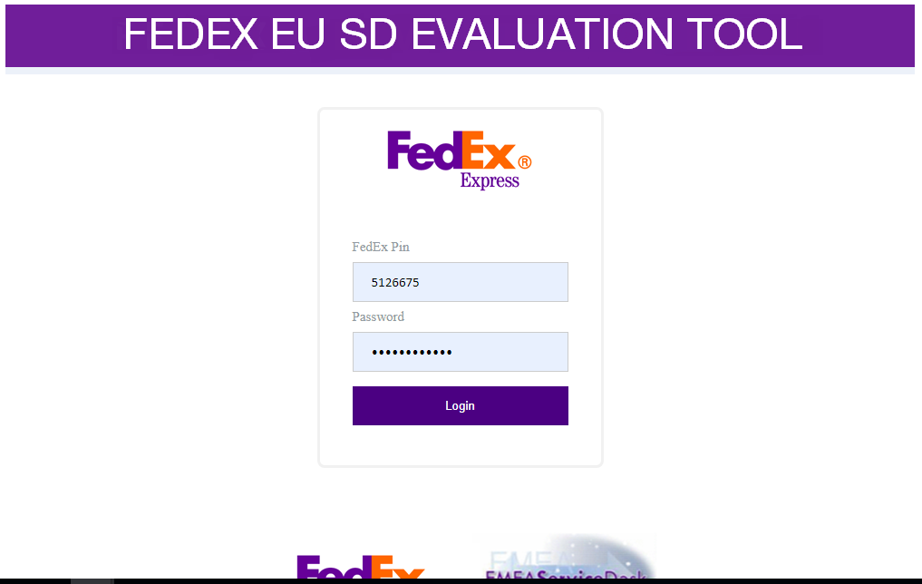
Login Screen

Slide 5
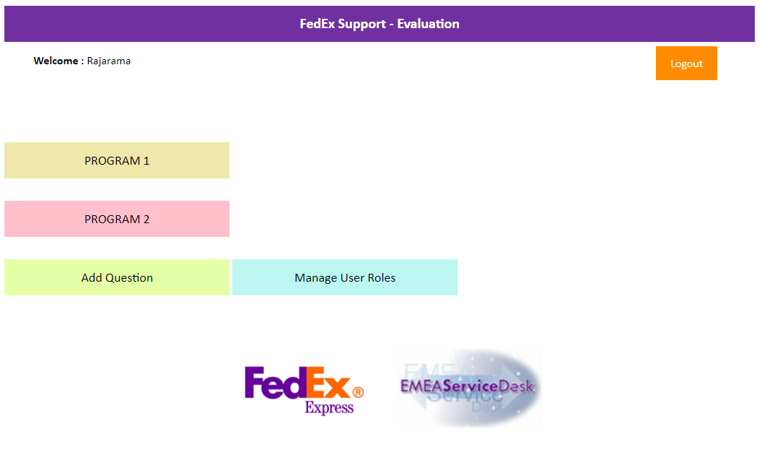
Home Page

Slide 6
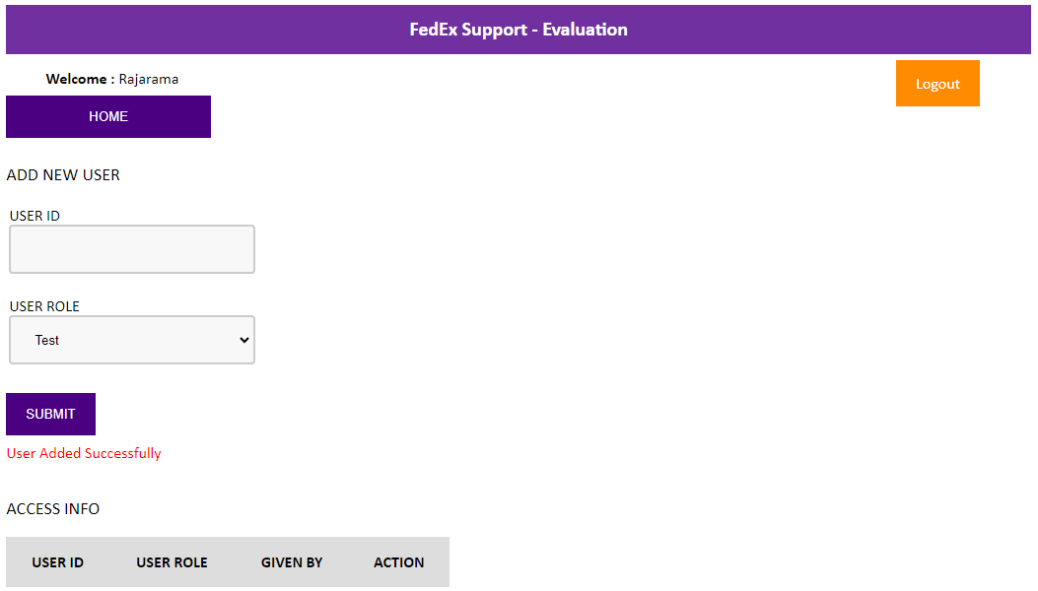
Manage User

Slide 7
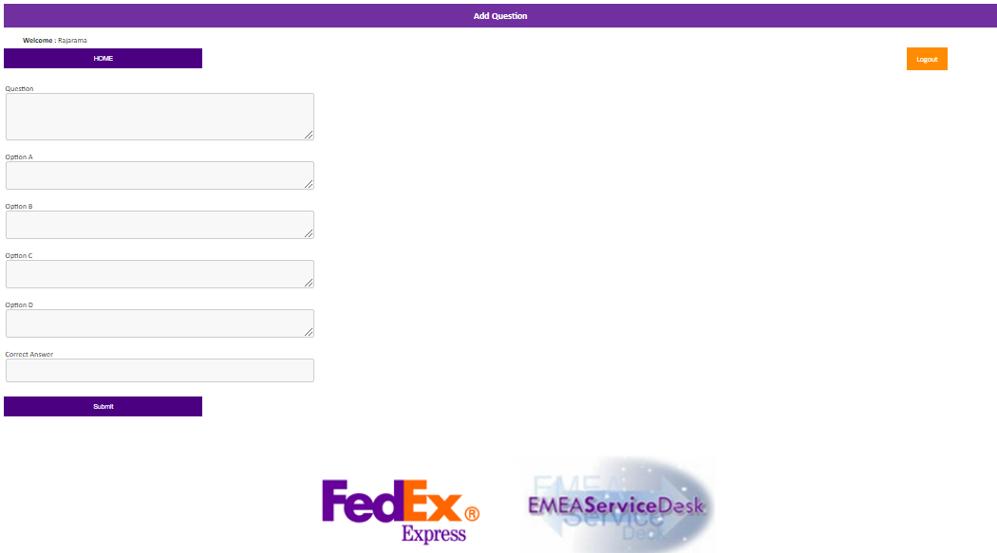
Add Question

Slide 8
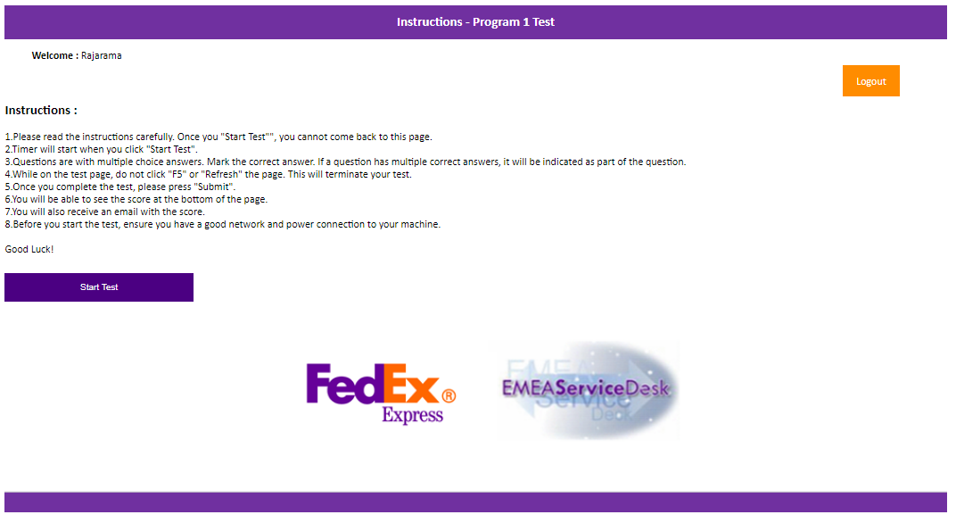
Test Screen

Slide 9
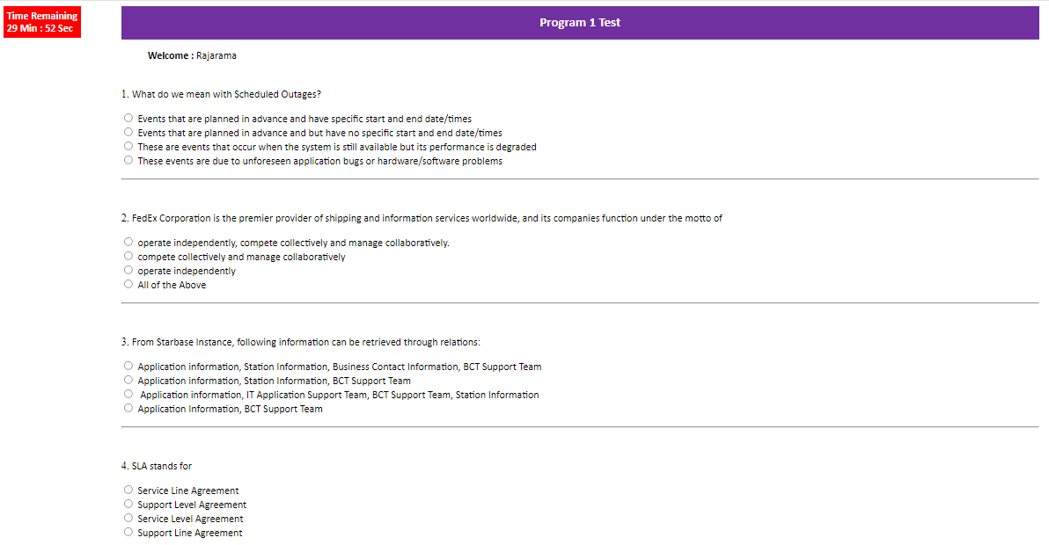
Take Test and Submit

Slide 10
About Mphasis
Mphasis (BSE: 526299; NSE: MPHASIS) applies next-generation technology to help enterprises transform businesses globally. Customer centricity is foundational to Mphasis and is reflected in the Mphasis’ Front2Back™ Transformation approach. Front2Back™ uses the exponential power of cloud and cognitive to provide hyper-personalized (C=X2C² _{TM}=1) digital experience to clients and their end customers. Mphasis’ Service Transformation approach helps ‘shrink the core’ through the application of digital technologies across legacy environments within an enterprise, enabling businesses to stay ahead in a changing world. Mphasis’ core reference architectures and tools, speed and innovation with domain expertise and specialization are key to building strong relationships with marquee clients. Click here to know

